Slide 1
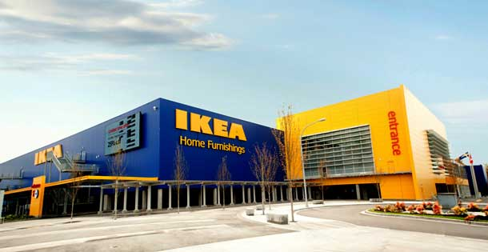
“Space to life”
Ikea is a private multinational that sells home furnishings all over the world since 1950 when it was founded by Ingvar Kamprad in Sweden.
Ajello Carroccia Zamagna 4°D

Slide 2
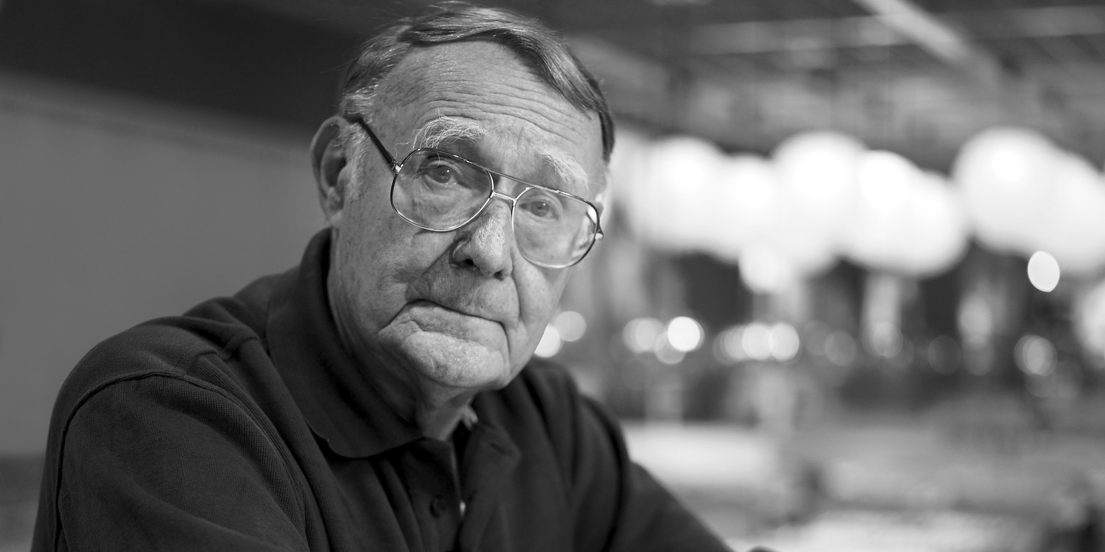
Ingvar Kamprad
He began by selling matches at the age of 9,
When he was 17 years old he built a warehouse called Ikea thanks to his father’s money
“Only those who are asleep make no mistakes”

Slide 3
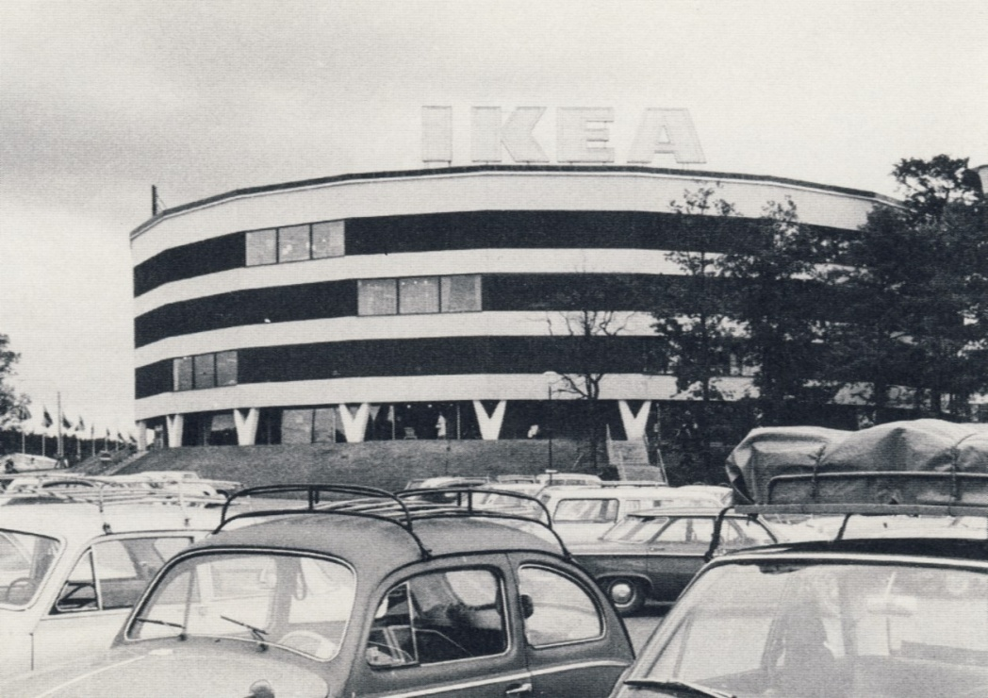
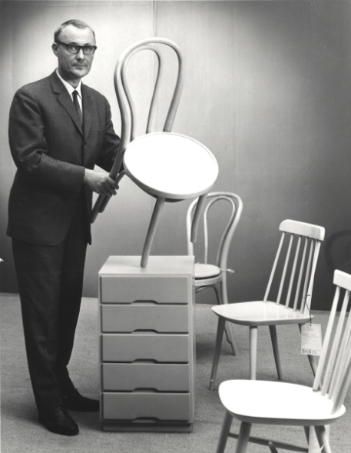
Start-up
At the beginning it sold pens, matches, plants and clocks
In 1950 it began selling furniture
Ikea opened the first branche in ‘60
1980 Ikea became famous around the world

Slide 4
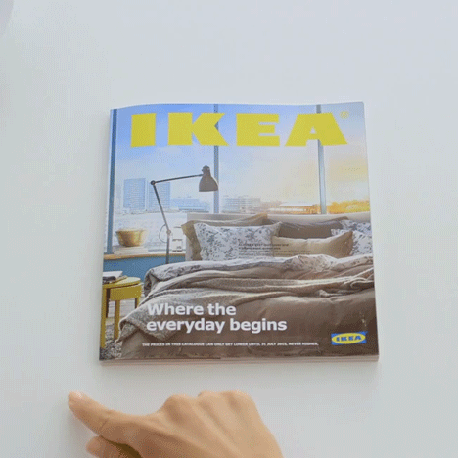
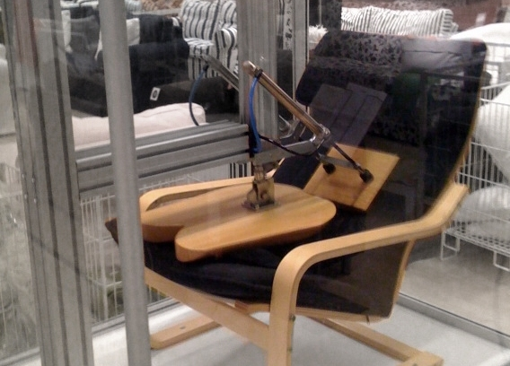
Why so successful?!
High quality at affordable prices
No chemical substances
Fidelity Card
Biannual Catalogues
No V.A.T.
Self-service restaurants

Slide 5
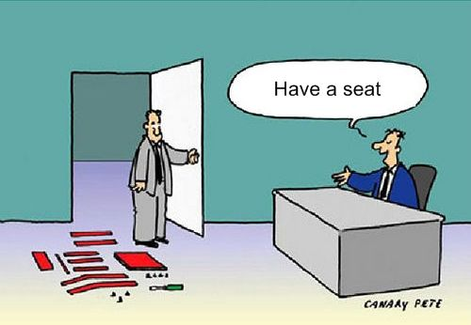
structure
Chairman: Lars-Johan Jarnheimer
President // CEO: Peter Agnefjall
Retail and Expansion Department:
About 110.000 employees
Production Department: About 20.000 employees
Range and Supply Department:
About 16.000 employees

Slide 6
Ikea gOSSIP
Ingvar Kamprad was accused of being a nazi
Kamprad is one of the richest man in the world
Ikea was under investigation because of tax avoidance
Ikea profits increase every year
Ajello Carroccia Zamagna 4°D

